Slide 1

UNIVERSITY INSTITUTE OF ENGINEERING
COMPUTER SCIENCE ENGINEERING
Master of Engineering
ADVANCED DATA STRUCTURES
&
ALGORITHMS
(23CSH-622)
INTRODUCTION
DISCOVER . LEARN . EMPOWER

Slide 2

ADVANCED DATA STRUCTURES
&
ALGORITHMS
(23CSH-622)
By : Dr. Ranjit Singh (E10947)
www. cuchd.in Campus : Gharaun, Mohali

Slide 3
TOPICS TO BE COVERED
INTRODUCTION TO HEAPS
ARRAY REPRESENTATION OF HEAPS
HEAP TYPES
ADDING/DELETING NODE FROM A HEAP
MAINTAINING A HEAP PROPERTY

Slide 4
The Heap Data Structure
Def: A heap is a nearly complete binary tree with the following two properties:
Structural property: all levels are full, except possibly the last one, which is filled from left to right
Order (heap) property: for any node x
Parent(x) ≥ x
8
7
4
5
2
A heap is a binary tree that is filled in order
Heap

Slide 5
When heaps are useful?
Heaps are used when the highest or lowest order/priority element needs to be removed. They allow quick access to this item in O(1) time. One use of a heap is to implement a priority queue.
Binary heaps are usually implemented using arrays, which save overhead cost of storing pointers to child nodes.

Slide 6
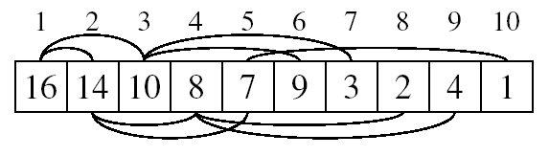
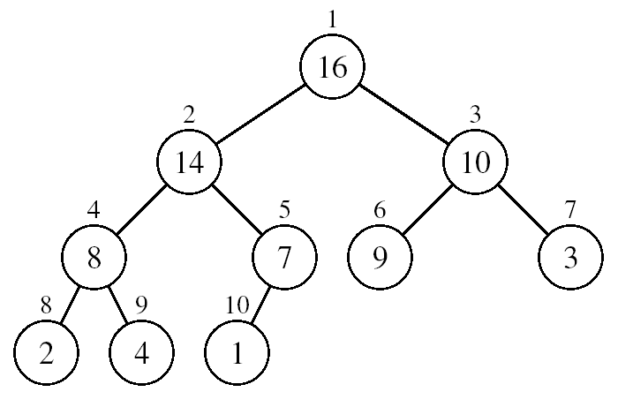
Array Representation of Heaps
A heap can be stored as an array A.
Root of tree is A[1]
Left child of A[i] = A[2i]
Right child of A[i] = A[2i + 1]
Parent of A[i] = A[ ⎣i/2⎦ ]

Slide 7
Heap of n elements is based on a complete binary tree so its height is log(n)
In complete binary trees, each level is filled up before another level is added and the levels are filled from left to right.

Slide 8
Heap Types
Max-heaps (largest element at root), have the max-heap property:
for all nodes i, excluding the root:
A[PARENT(i)] ≥ A[i]
Min-heaps (smallest element at root), have the min-heap property:
for all nodes i, excluding the root:
A[PARENT(i)] ≤ A[i]

Slide 9
Adding/Deleting Nodes
New nodes are always inserted at the bottom level (left to right)
Nodes are removed from the bottom level (right to left)

Slide 10
Operations on Heaps
Maintain/Restore the max-heap property
MAX-HEAPIFY
Create a max-heap from an unordered array
BUILD-MAX-HEAP
Sort an array in place
HEAPSORT

Slide 11
Construction of heap tree and insertion
Insert key one by one
Heapify Method
Insertion in Heap Tree
Step 1 − Create a new node at the end of heap.
Step 2 − Assign new value to the node.
Step 3 − Compare the value of this child node with its parent.
Step 4 − If value of parent is less than child, then swap them.
Step 5 − Repeat step 3 & 4 until Heap property holds.

Slide 12
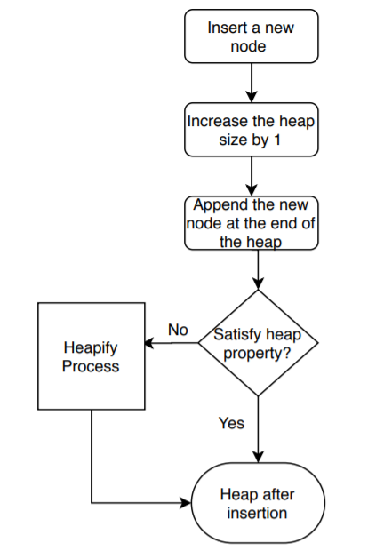
Insertion in Heap Tree

Slide 13
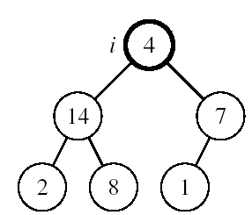
Maintaining the Heap Property
Suppose a node is smaller than a child
Left and Right sub trees of i are max-heaps
To eliminate the violation:
Exchange with larger child
Move down the tree
Continue until node is not smaller than children

Slide 14
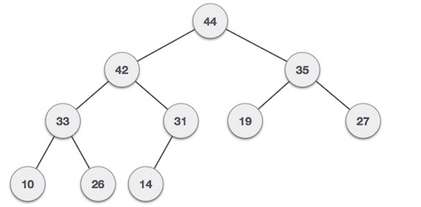
35 33 42 10 14 19 27 44 26 31
Max Heap

Slide 15
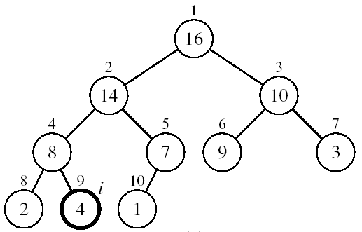
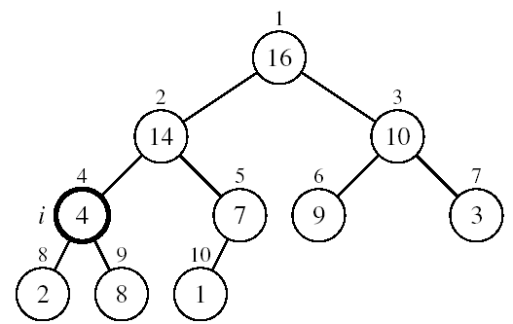
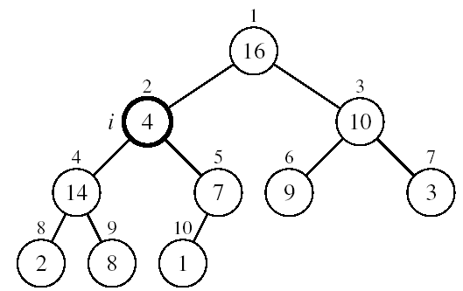
Example
MAX-HEAPIFY(A, 2, 10)
A[2] ↔ A[4]
A[2] violates the heap property
A[4] violates the heap property
A[4] ↔ A[9]
Heap property restored

Slide 16
145,40,25,65,12,48,1,100,27,7,3,45,9,30
Construct Min Heap:

Slide 17
Deleting the root of the Heap
The standard deletion operation on Heap is to delete the element present at the root node of the Heap. That is if it is a Max Heap, the standard deletion operation will delete the maximum element and if it is a Min heap, it will delete the minimum element.
Assign the Root R to some variable ITEM
Replace the deleted node R by last node of tree , so that tree is complete binary tree not necessarily Heap Tree.
Re-Heapify.

Slide 18
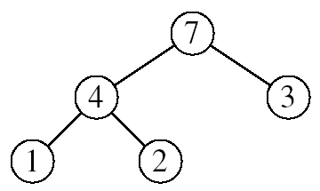
Heapsort
Goal:
Sort an array using heap representations
Idea:
Build a max-heap from the array
Swap the root (the maximum element) with the last element in the array
“Discard” this last node by decreasing the heap size
Call MAX-HEAPIFY on the new root(Re heapify)
Repeat this process until only one node remains

Slide 19
Example..
Sort elements through heapsort (max heap)
15,20,7,9,30
81,89,9,11,14,76,54,22

Slide 20
Advantages of Heap sort
Efficiency – The time required to perform Heap sort increases logarithmically while other algorithms may grow exponentially slower as the number of items to sort increases. This sorting algorithm is very efficient.
Memory Usage – Memory usage is minimal because apart from what is necessary to hold the initial list of items to be sorted, it needs no additional memory space to work

Slide 21
Disjoint Set Data Structure, Augmented data structure---for self reading

Slide 22
References
Li`pschutz, Seymour, “Data Structures”, Schaum's Outline Series, Tata McGraw Hill.
Data structure and algorithm by Narasimha Karumanchi.
www.tutorialspoint.com
www.geeksforgeeks.com
22

Slide 23
Books Recommended
Goodrich, Michael T., Tamassia, Roberto, and Mount, David M., “Data Structures and Algorithms in C++”, Wiley Student Edition.
Aho, Alfred V., Ullman, Jeffrey D., Hopcroft ,John E. “Data Structures and Algorithms”, Addison Wesley
Lipschutz, Seymour, “Data Structures”, Schaum's Outline Series, Tata McGraw Hill.
Gilberg/Forouzan,” Data Structure with C ,Cengage Learning.
Augenstein,Moshe J , Tanenbaum, Aaron M, “Data Structures using C and C++”, Prentice Hall of India

